Slide 1
MAE 598 : Introduction to Autonomous Vehicle Engineering
Final Project Presentation
Predictive Modeling for Tilt Control:
Data Science Approach to Enhance Ride Comfort
Sherry Daniel Sajan (1225838460)
Swetha Tirumala (1229953818)
VVS Krishna Vamshi (1229568654)

Slide 2
Contents
Objective/Problem Statement
Introduction
Solution Approach
Methodology
Results
Challenges
Future Scope

Slide 3
Problem Statement
This project aims to develop machine learning models for predicting vehicle tilt angles during maneuvers through curves and turns, enhancing passenger comfort. Additionally, the project seeks to evaluate and compare the performance of these machine learning models to discern optimal methodologies.

Slide 4
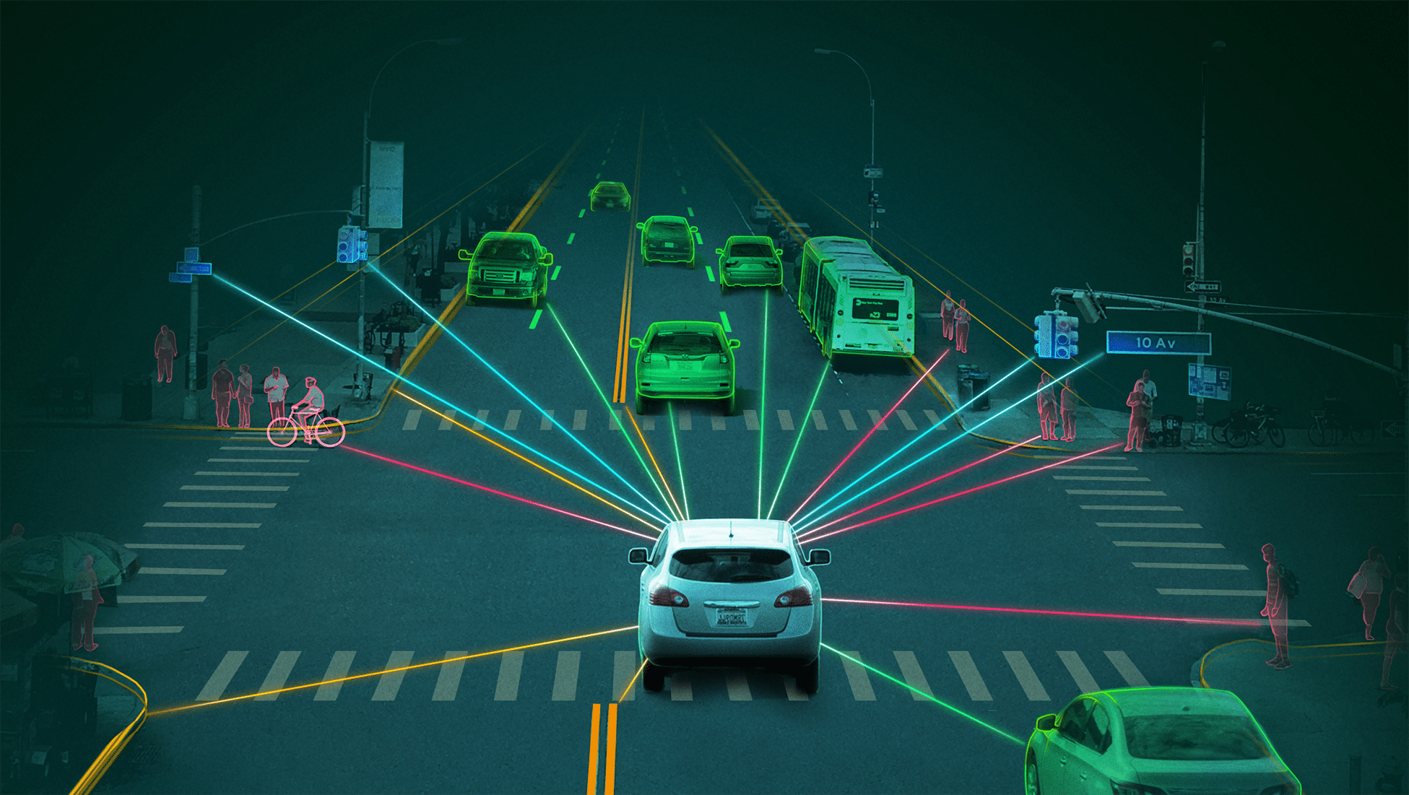
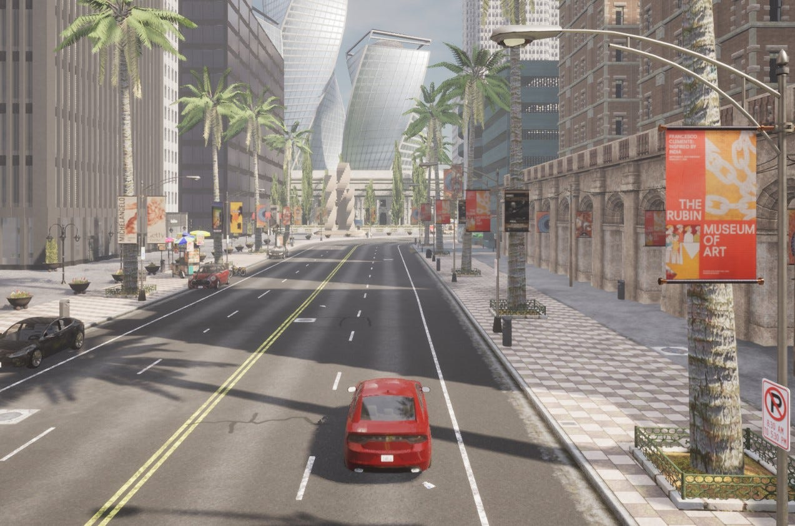
Introduction
Curve Tilting can help in reducing the centrifugal force experienced by the passengers when a vehicle is taking a turn.
It is achieved by counteracting the lateral acceleration experienced during curves.
In the era of autonomous vehicles, passenger well being, safety and improving the overall user experience is essential for the widespread adoption of these technologies.

Slide 5
Solution Approach
Collect the data from CARLA Car Simulator using the sensor data.
Train a neural network with this data where the angle of tilt is calculated using the vehicle dynamics.
Finally, predict the tilt angle and test for different inputs.
Evaluate performance of various ML algorithms and efficiency of prediction.

Slide 6

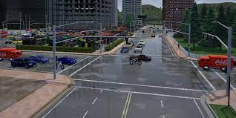
CARLA (Car learning to act) simulator
CARLA is an Open-Source resource used for development, training, and validation of autonomous driving systems.
CARLA provides open digital assets (urban layouts, buildings, vehicles) that were created for this purpose and can be used freely.
It also offers a wide scope of sensor suites, environmental variables, full control of all static and dynamic actors, maps generation, and much more attributes.

Slide 7

Reference : https://www.youtube.com/watch?v=-L9VuPpzVdQ

Slide 8
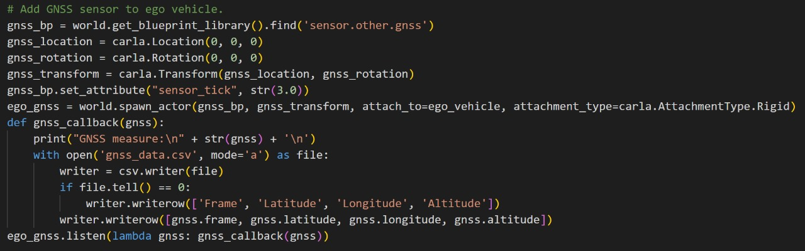
Methodology - Data collection using CARLA
In Carla Simulator, we used the GNSS and IMU sensors
GNSS (Global Navigation Satellite System) : Uses the satellite signals to process the vehicle’s velocity, position and orientation
IMU (Inertial Measurement Unit): Measures the vehicle’s angular acceleration and velocity in all three directions(x,y,z)

Slide 9

CARLA Simulation Video

Slide 10
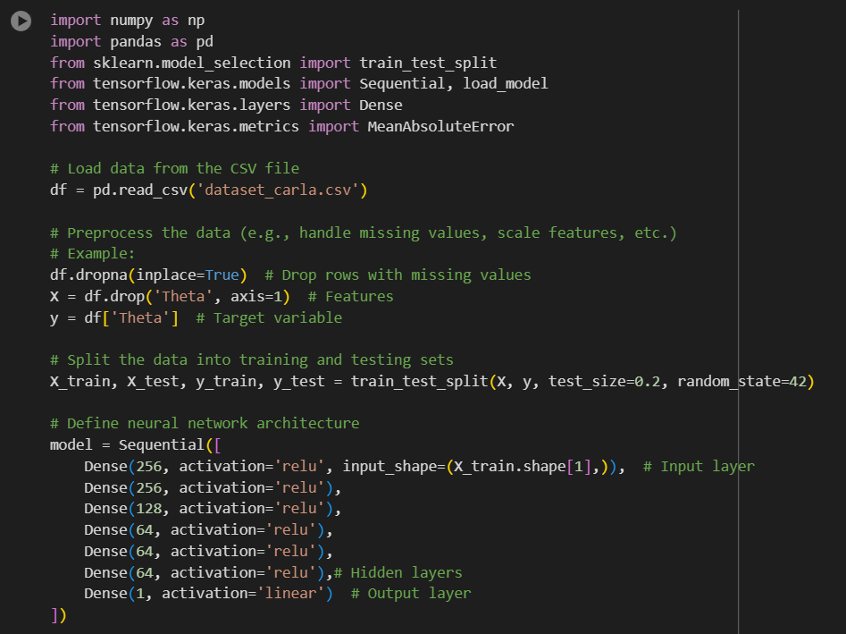
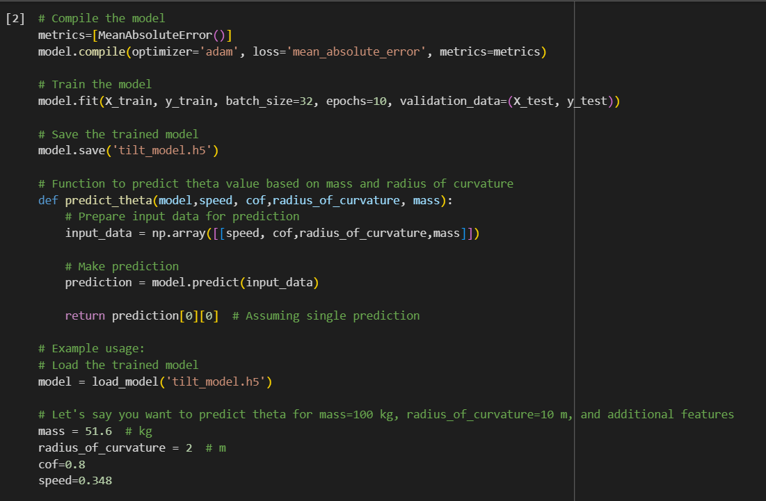
Methodology - Training the Neural Network
The data is extracted from the sensors in the simulator and a neural network is trained on it. Then the tilt angle is predicted using different inputs such as of mass, radius of curvature, speed and coefficient of friction

Slide 11
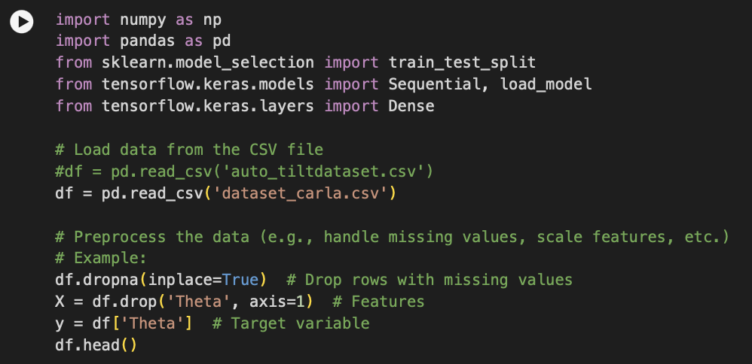
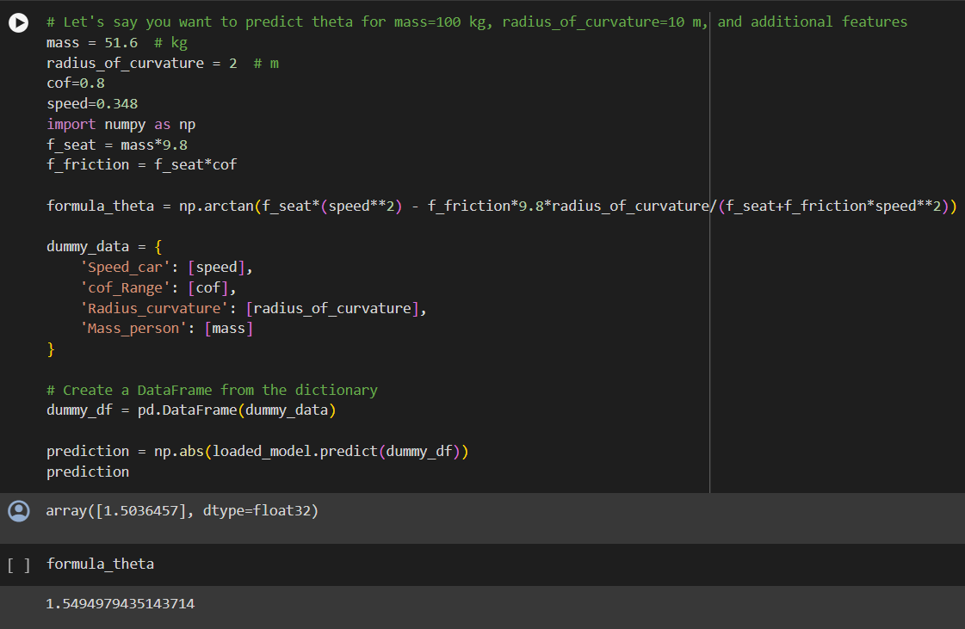
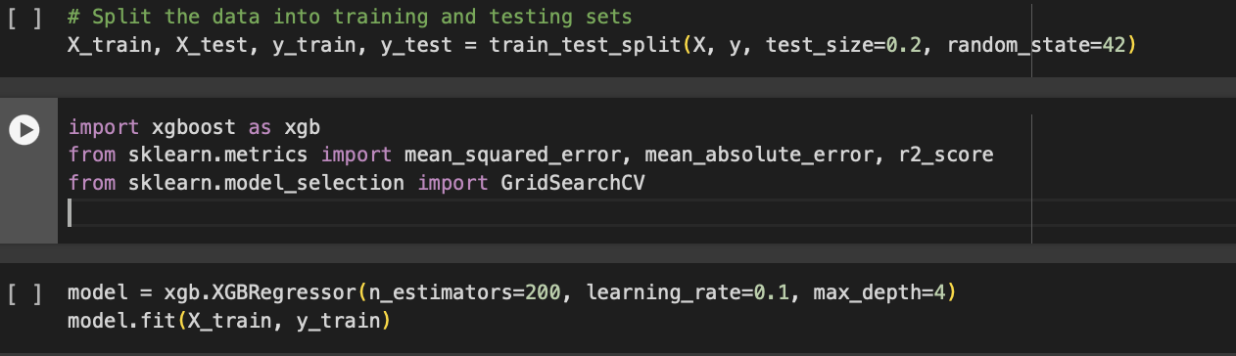
Methodology - Training the Decision tree
The decision tree has been trained with the same dataset acquired from Carla and tilt has been predicted.
Furthermore, both these ML algorithms have been compared with respect to various aspects.

Slide 12
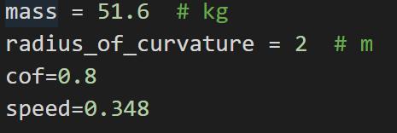
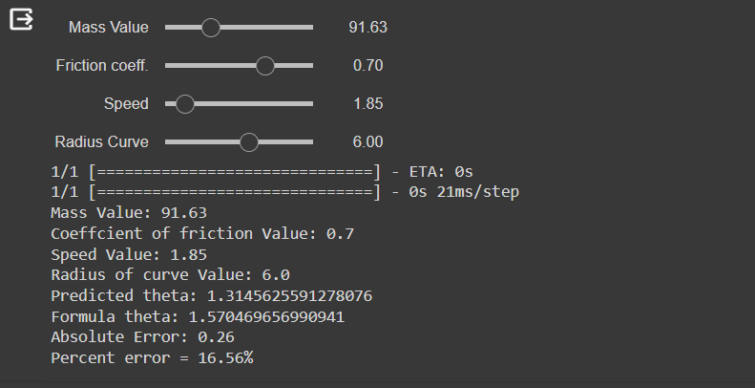
Results - Feed Forward Neural Network
The dataset is loaded and is split into 80% training and 20% testing data and the model is trained.
The input layer takes a total of 4 features: speed, coefficient of friction, radius of curvature, and mass.
There are 5 hidden layers each hidden layer consists of 256 nodes, 128 nodes, and 64 nodes in first two layers, third layer and the remaining three layers.

Slide 13
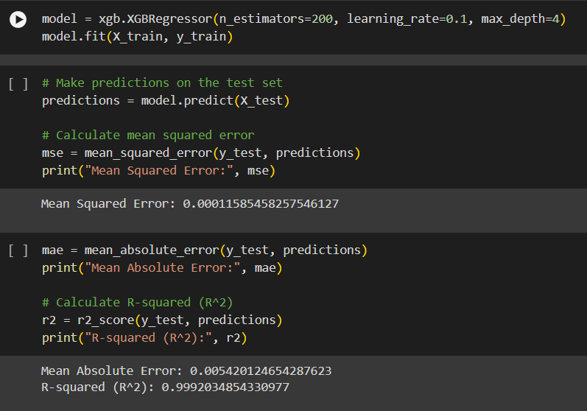
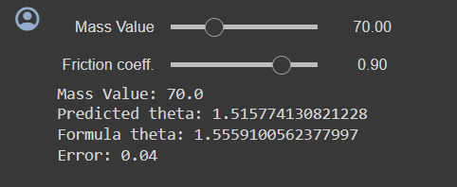
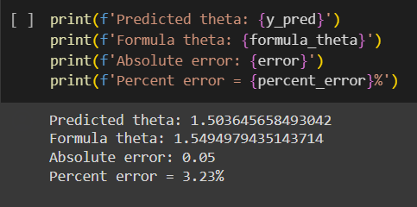
Results - Decision Tree Model
The data is loaded as features and target (theta).
The data is split into training and test with a 80/20 split.
The XGBoost regressor is trained by initialising with the following hyperparameters: - no. of estimators = 100 - learning rate = 0.1 - tree depth = 4
After training, the model is evaluated on the test set.
The trained model is loaded to predict on new dataset.

Slide 14
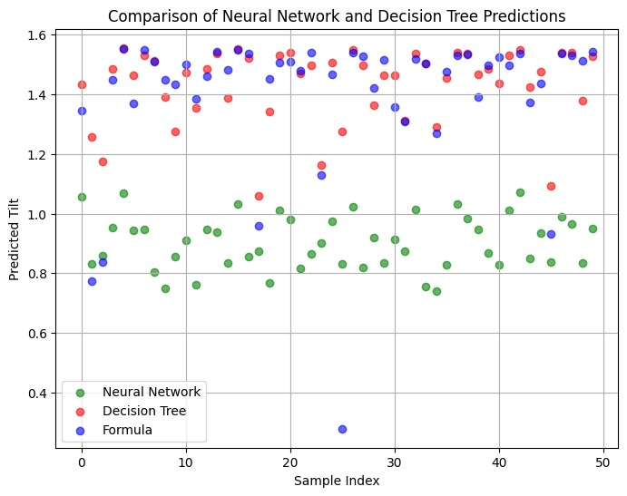
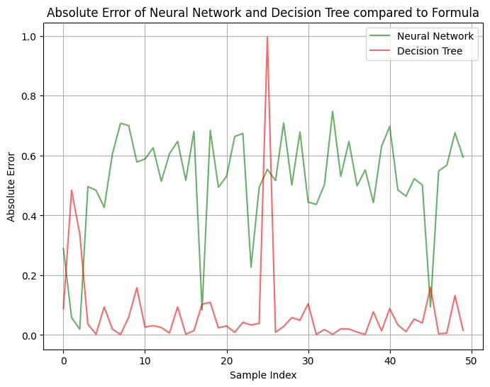
Neural network Vs Decision tree

Slide 15
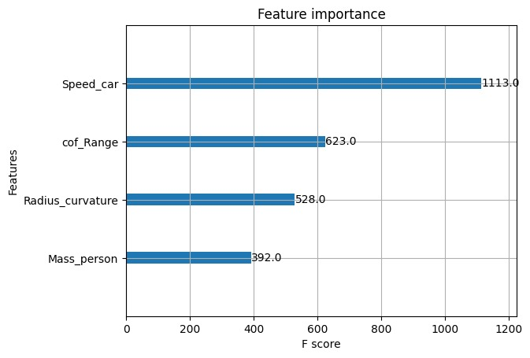
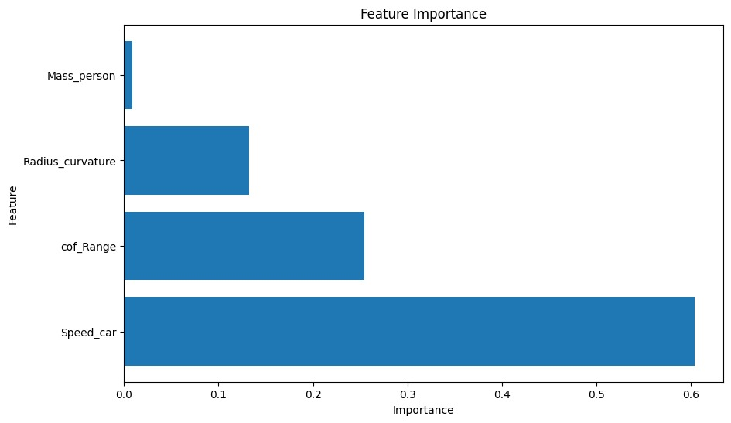
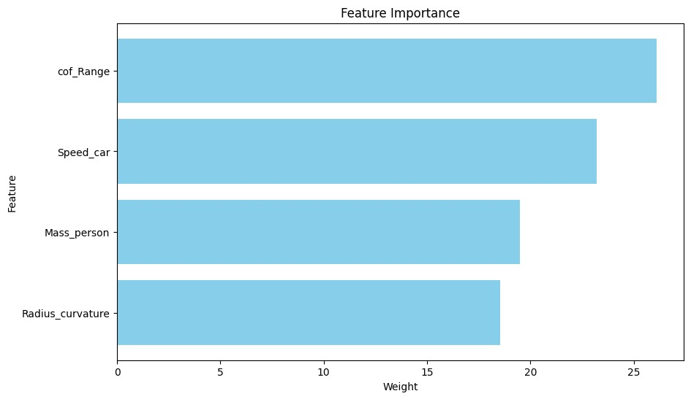
Feature Importance Graphs

Slide 16
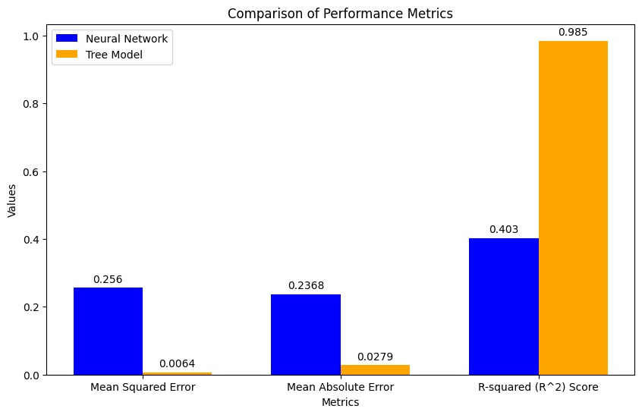
Performance Metrics
MAE: It provides a measure of the model's accuracy without considering the direction of the errors.
MSE: It penalizes larger errors more than smaller ones due to squaring each difference.
R² Score: It shows how well the data fit the regression model. It is a statistical measure in a regression model.

Slide 17
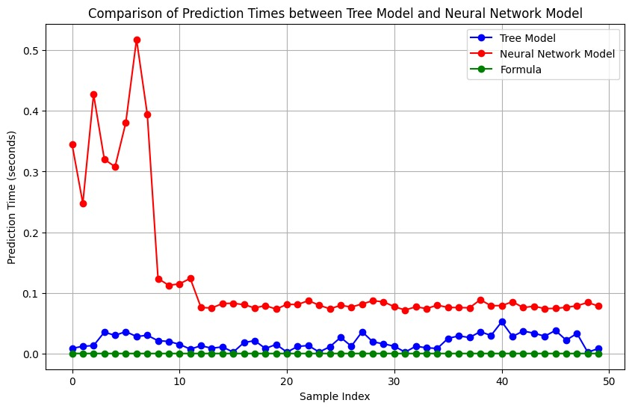
Prediction Times of Various Methods
Decision Tree-Avg. time taken for prediction: 0.019460105895996095sec.
NN-Avg. time taken for each prediction: 0.12813262939453124sec.
Direct Formula-Avg. Time taken for formula: 0.00000065385600 sec.

Slide 18
Challenges & Learnings
Obtaining comprehensive and accurate data from CARLA Simulator.
Limited computing power and resources to run CARLA simulator.
Identifying the most appropriate features (mass, speed, etc) to feed as an input to the models.
Developing effective metrics beyond simple prediction accuracy.
Testing models on diverse scenarios to assess real-world applicability.
Implementation and application of various Machine Learning algorithms.
Awareness about different A.V. simulators and resources.

Slide 19
Future Scope
Implementation of this predictive model and consequent testing and validation of results.
Improving feedback mechanisms to enable the vehicle to adapt its tilt angle in response to unexpected obstacles or road conditions.
Expanding the use of simulators to generate vast amounts of data covering diverse scenarios for more comprehensive model training and testing.
Investigating more advanced machine learning algorithms or hybrid models to improve prediction accuracy and robustness.

Slide 20
References
Curve Tilting with Nonlinear Predictive Control for enhancing Motion comfort- 10.1109/TCST.2021.3113037
Carla simulator https://carla.org/
Carla documentation : https://carla.readthedocs.io/en/latest/
Youtube : https://www.youtube.com/watch?v=FwCiSRG0mp4&list=PL3lTgNaX8q9p_FJWUJHPrYYC5KE5_FaQo
Youtube : https://www.youtube.com/watch?v=J1F32aVSYaU&list=PLQVvvaa0QuDeI12McNQdnTlWz9XlCa0uo

Slide 21
Thank you :)
Questions??

